Slide 1
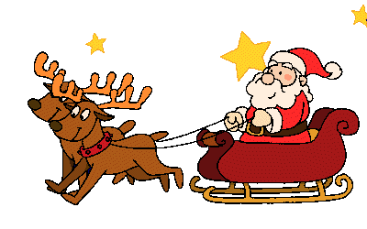
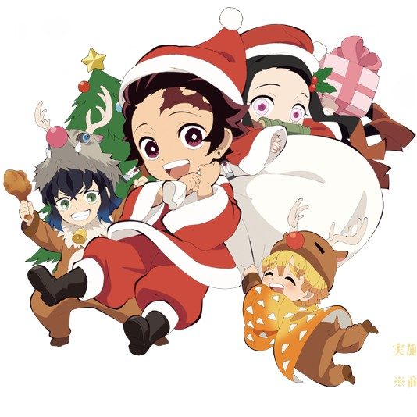
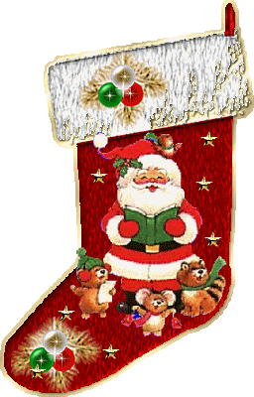
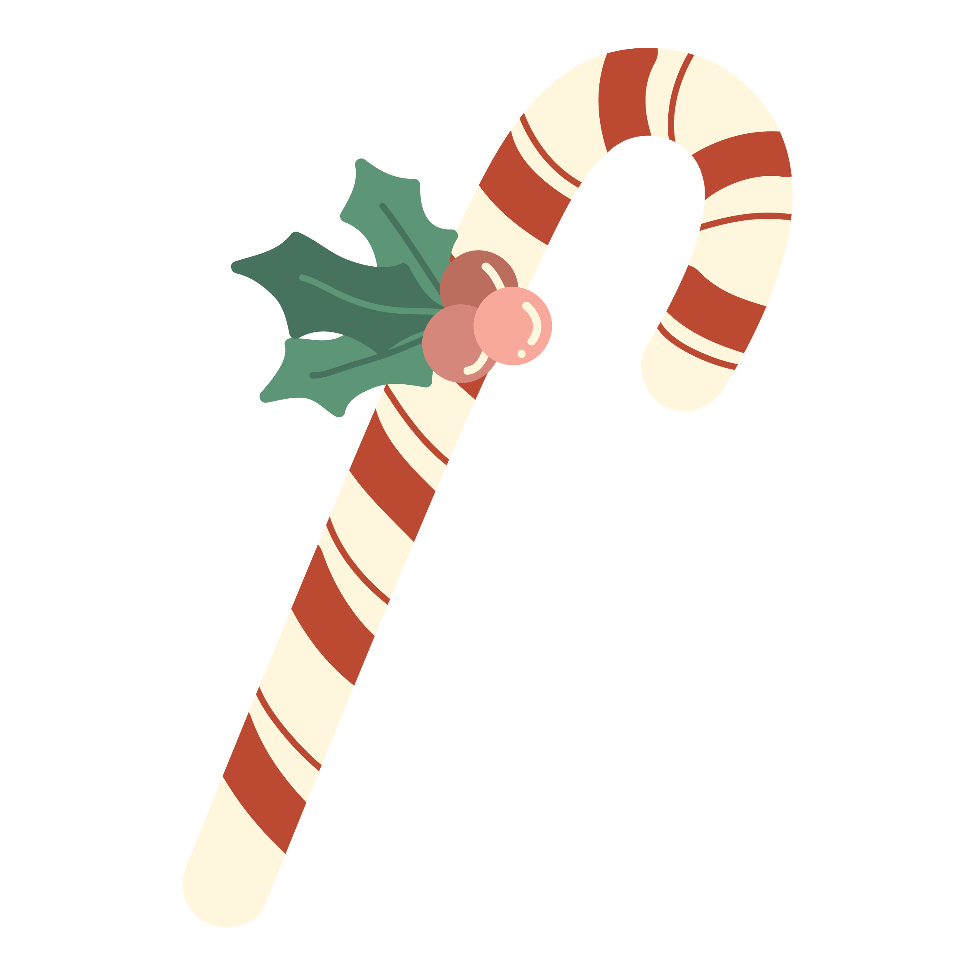
How do the foreigners celebrate X’mas II?

Slide 2
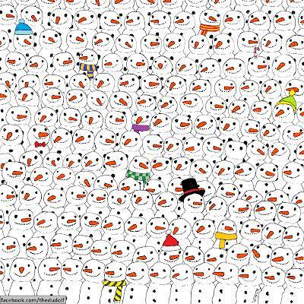
Where’s the panda?

Slide 3
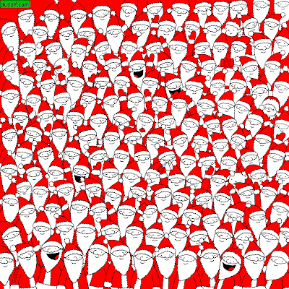
Can YOU find:
- Mrs. Claus
- a grumpy Santa
- a Snowman
- a bell
- a polar bear
- an elf
- and an apple?

Slide 4
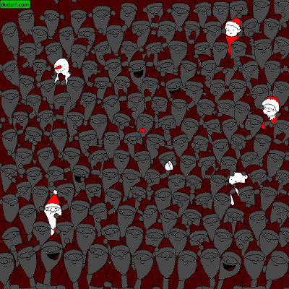

Slide 5
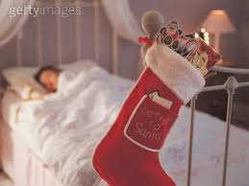
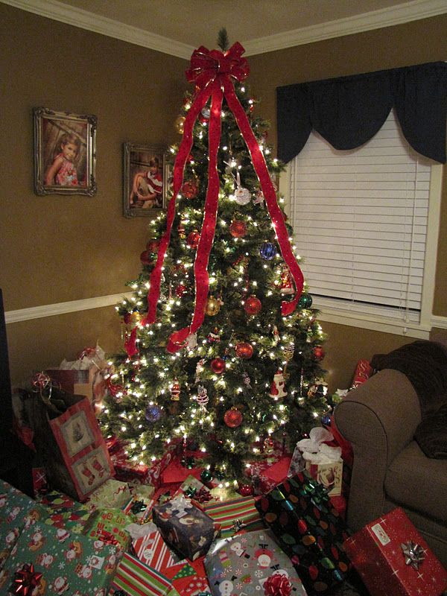
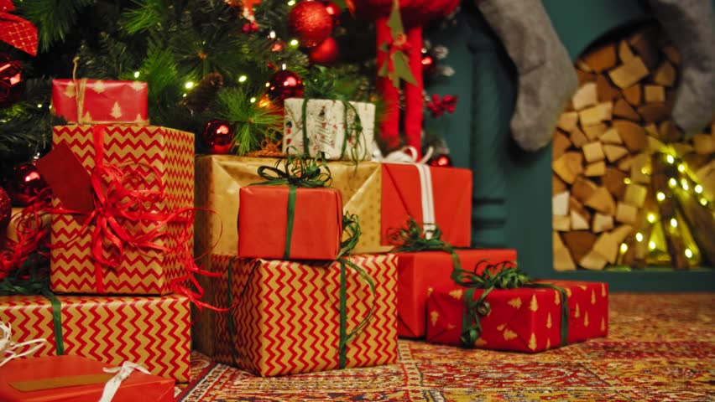
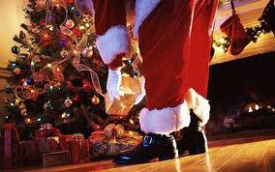
On 24th of December, Christmas Eve, children put their stockings at the end of their beds and in the night, Santa Claus brings them presents.
He fills their stockings with presents and puts more presents under the Christmas tree.

Slide 6
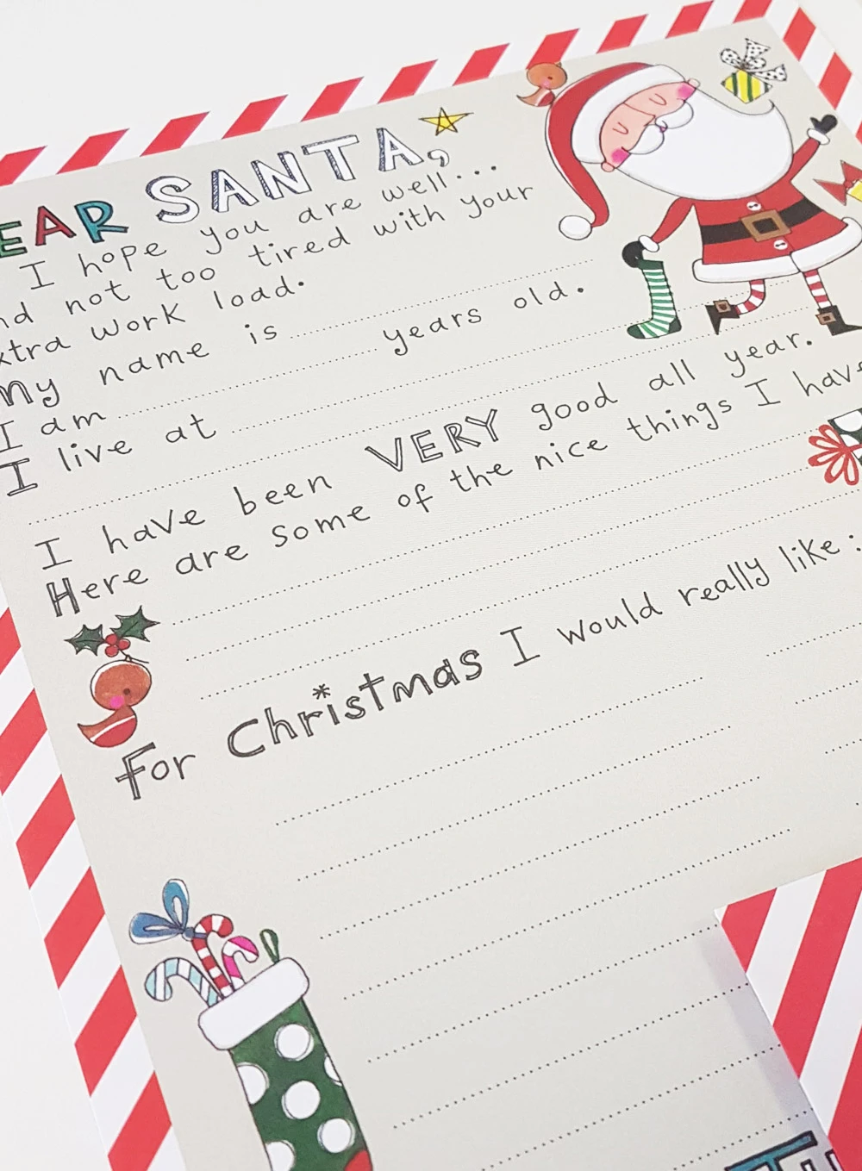
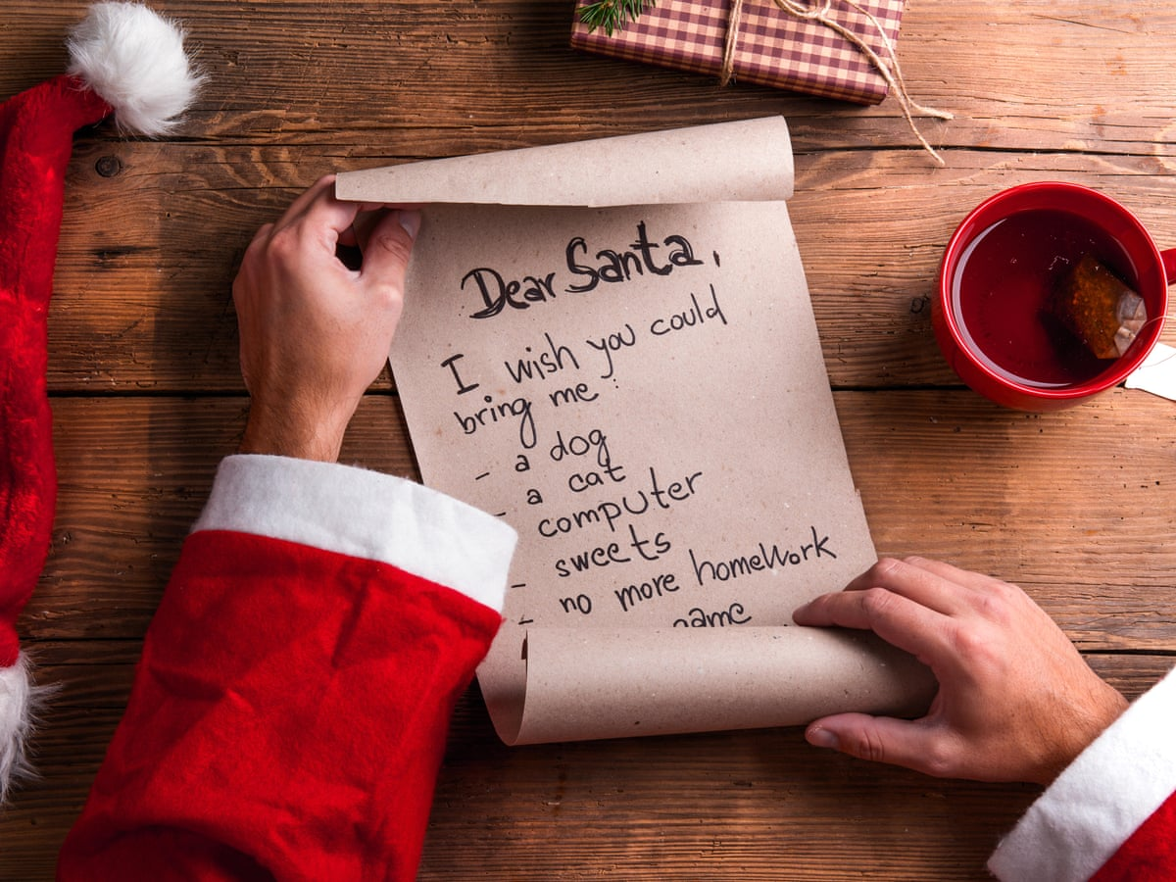
In November or December children write a letter to Santa with a list of toys they would like.

Slide 7
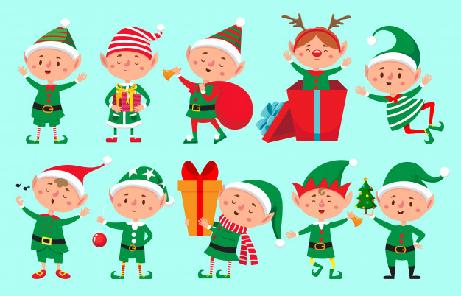
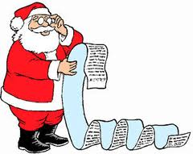
Santa lives in the North pole and when he reads the letters from the children, he asks his elves to make the gifts.

Slide 8
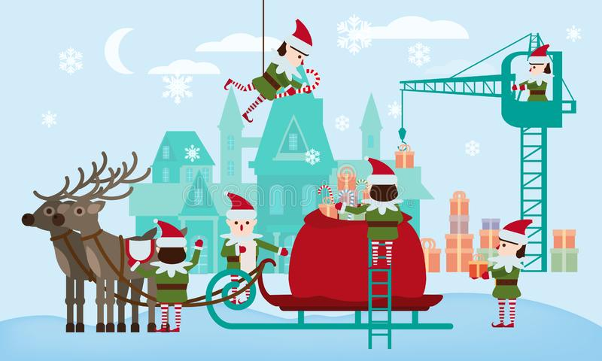
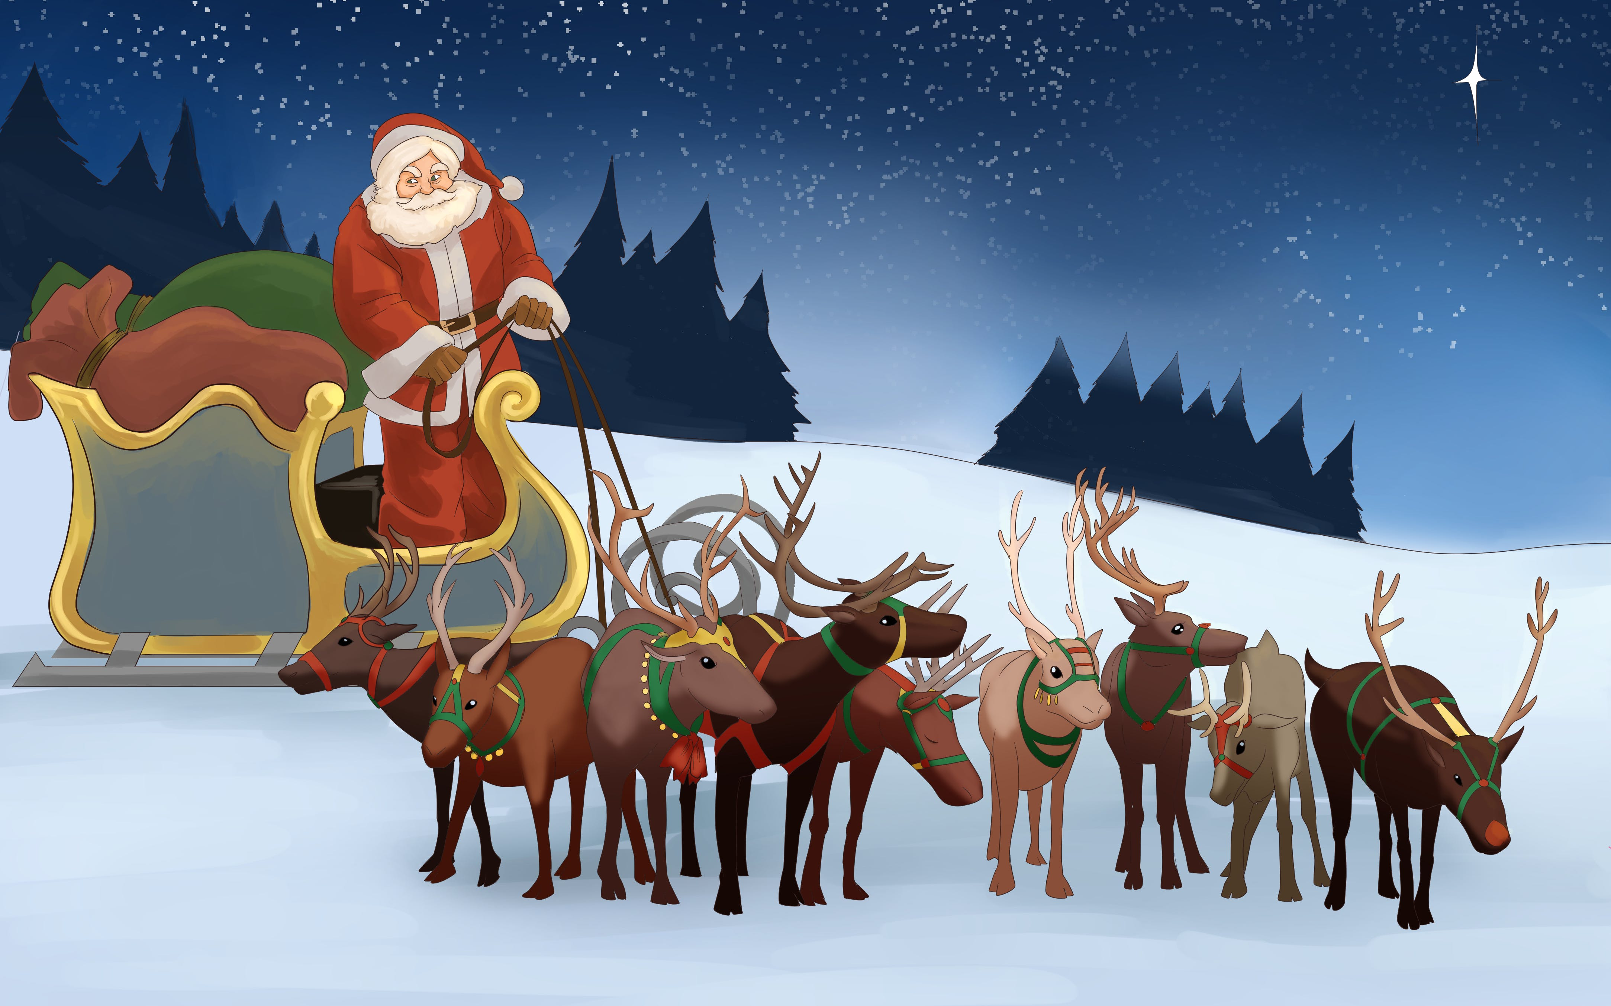
On Christmas eve, the elves put all the presents on Santa´s sleigh , and ready to deliver them to the children. Meanwhile, Santa prepares the reindeer.

Slide 9
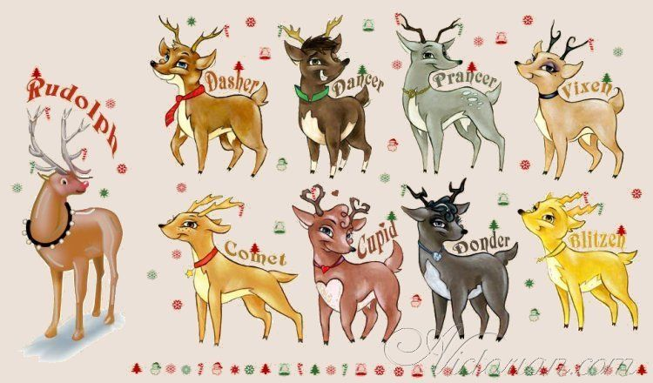
Santa’s sleigh is pulled by 9 reindeer.

Slide 10
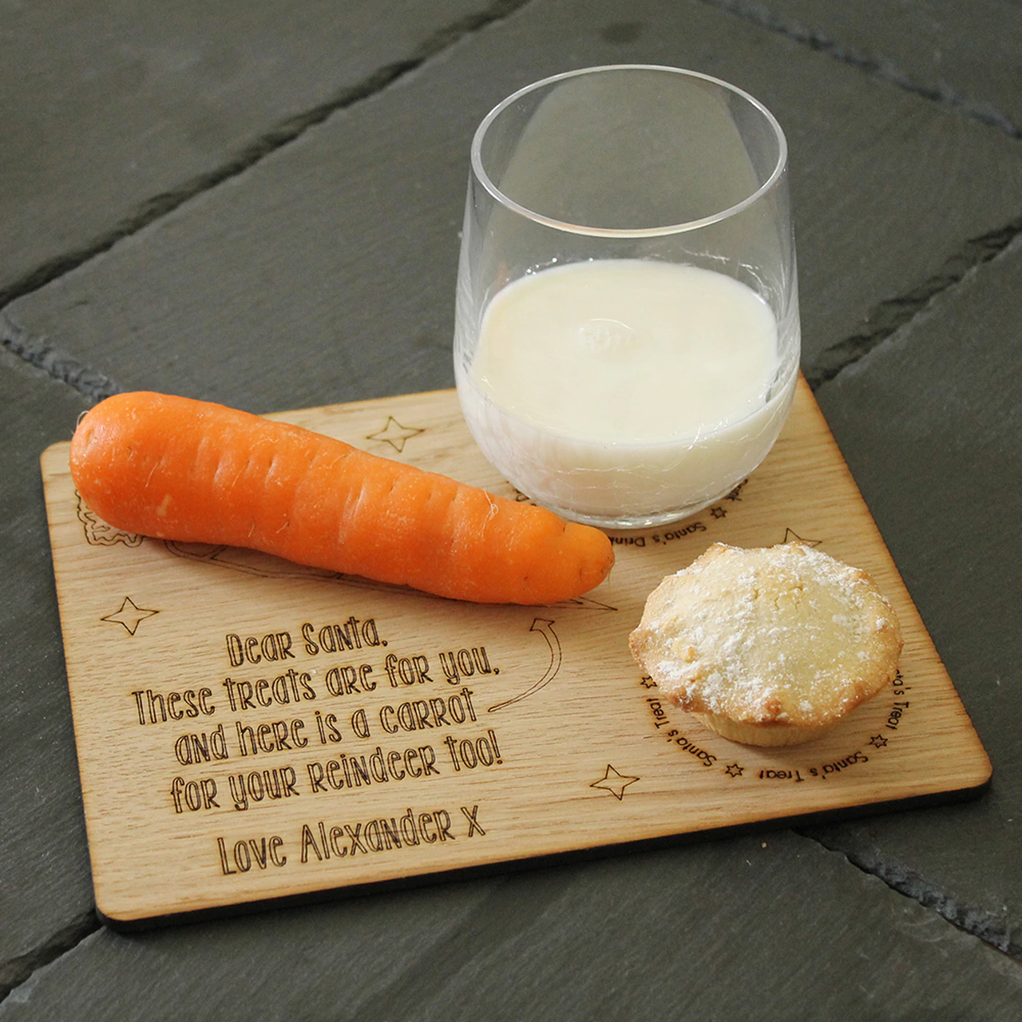
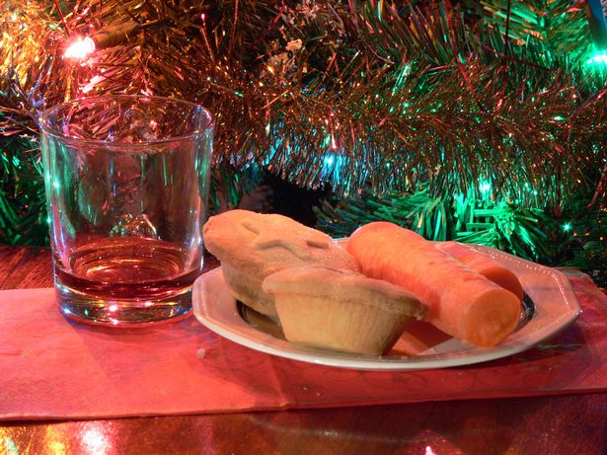
Before the boys and girls go to bed, they leave a little present for Santa and his reindeer.
Mince pies and a glass of drink for Santa, and carrots for his reindeer.

Slide 11
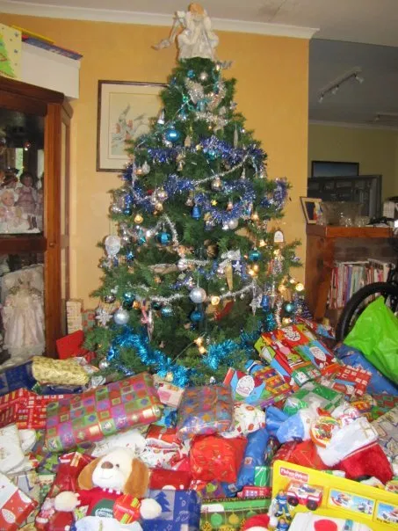
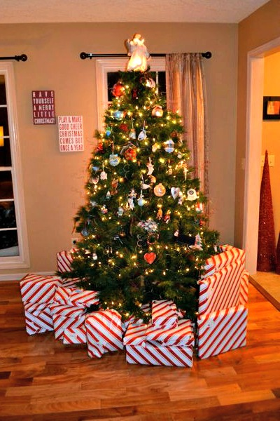
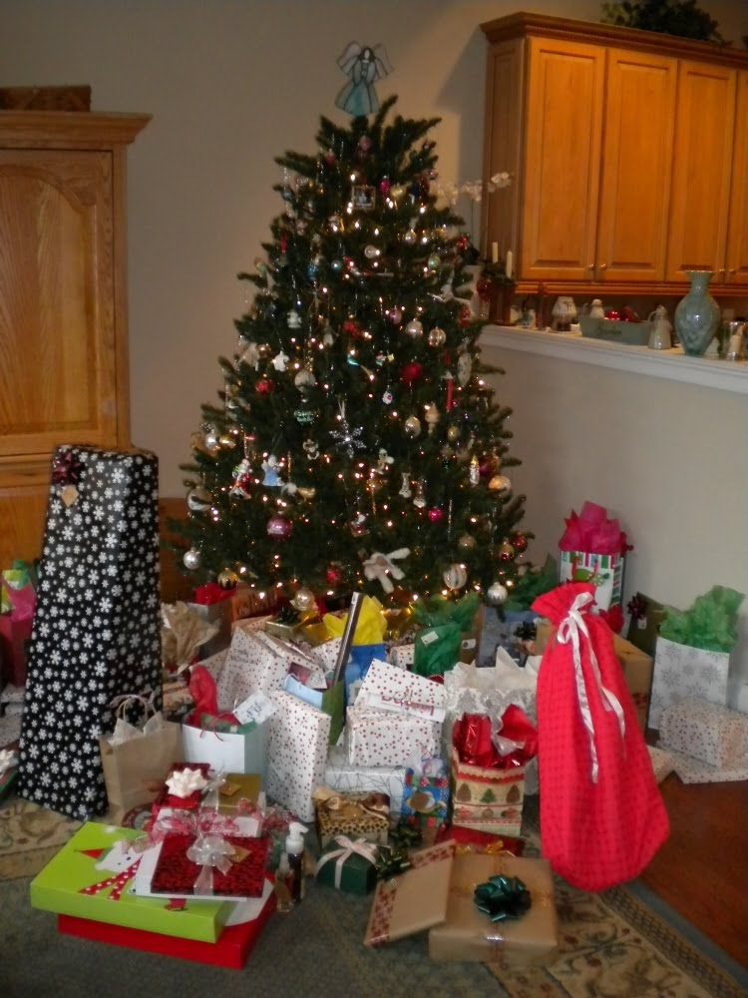
On Christmas Day (12/25)morning, when the children wake up, they find lots and lots of presents under the Christmas tree!

Slide 12
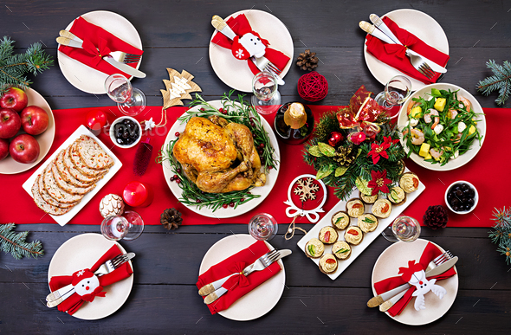
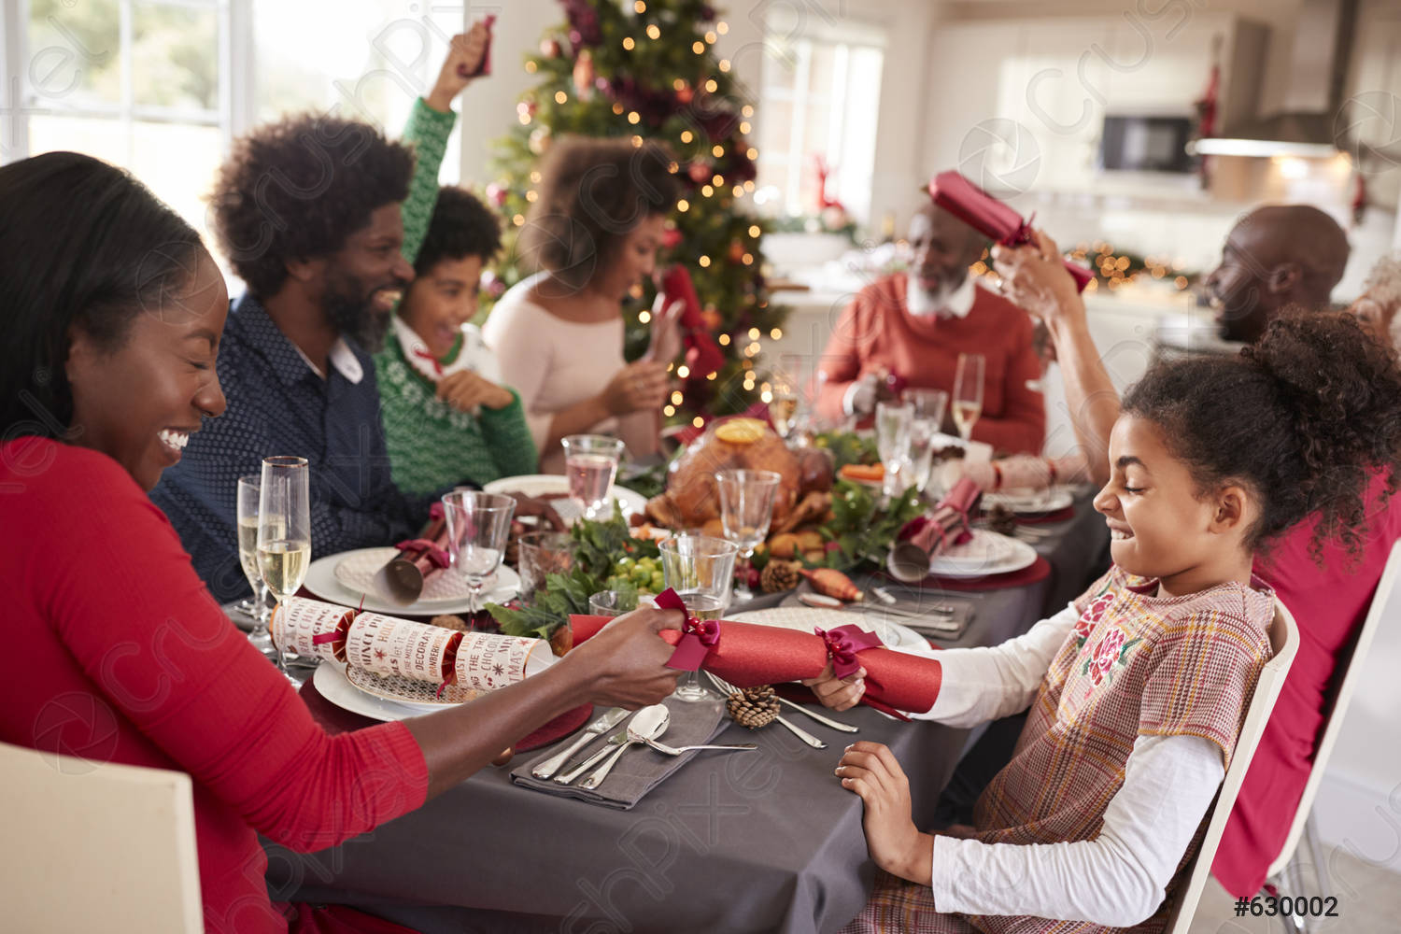
An important part of Christmas Day is the Christmas dinner. They eat a big dinner with friends and family members. People decorate their dinner tables with candles, napkins and crackers.

